Slide 1
Object Oriented Design and UML

Slide 2
Few Design Concepts
Abstraction
  Concentrate on a a problem at some level of generalization without regard to irrelevant low level details.
Refinement
  Top down design strategy that successively refines the levels of procedural details.
  Every refinement step involves Design Decisions.
Modularity
  Divide the software into separately named and addressable components, that are integrated to satisfy the problem requirements.

Slide 3
Modularity
Easier to manage
Easier to understand
Reduces complexity
Delegation / division of work
Fault isolation
Independent development
Separation of concerns
Reuse

Slide 4
Modular Design
How to decompose a software system into best set of modules?
  Information hiding
  Functional independence
  Cohesion
  Coupling

Slide 5
Information Hiding
Modules to be characterized by design decisions that hide from all others.
Design the modules in such a way that information (data & procedures) contained in one module is inaccessible to other modules.
Independent modules.
Benefits:
  when modifications are required, it reduces the chances of propagating to other modules.

Slide 6
Information Hiding
public class PersonalInfo {
  public String name;
  public String City;
  private int age;
}
person1.age=25; ?

Slide 7
Functional Independence
Develop modules with “single-minded” function.
Each module addresses a specific sub function of requirements and has a simple interface when viewed from other parts of the system.
Functions are compartmentalized and interfaces are simplified.
Benefits:
  Error propagation is reduced and can lead to reusability of modules.

Slide 8
Cohesion
An extension of Information hiding and functional independence.
“A module should ideally do one thing.”
Each module performs a single task requiring little interaction with other modules.
High cohesion is good
  Changes are likely to be local to a module
  Easier to understand a module in isolation

Slide 9
Coupling
A measure of interconnection among modules in a software structure.
Depends on the interface complexity between the modules.
Number of dependencies between modules.
High coupling causes problems
  Change propagation- ripple effect
  Difficulty in understanding
  Difficult reuse

Slide 10
Object-Oriented Paradigm
  Describing the software solution in terms of collaborating objects, with responsibilities.
  Objects,
  classes,
  encapsulation,
  States,
  inheritance,
  composition,
  polymorphism

Slide 11
Benefits of OO
Enjoys all the benefits of Modular approach
Dependencies can be handled by finding the commonalities through inheritance and polymorphism.
Built-in libraries in OOP.
Naturalness
  OO paradigm models the real world better because everything in real world is an object.
Reusability
  Using the existing classes or components in future design, without much effort.

Slide 12
Structured vs Object Oriented Paradigm
In structured design, data and functions are kept separately.
Usually all of the data are placed before any of the functions are written.
Sometimes, it is not intuitively known which data works with which function.
In OO design, the related data and functions of an object are placed together within one unit.

Slide 13
Software Design in terms of Objects
Objects are abstractions of real-world or system entities and manage themselves.
Objects are independent and encapsulate state and representation information.
System functionality is expressed in terms of object services.
Objects communicate by message passing.

Slide 14
Objects & Object Classes
An object is an entity that has a state and a defined set of operations which operate on that state.
Objects are created according to some object class definition.
  An object class definition serves as a template for objects. It includes declarations of all the attributes and services which should be associated with an object of that class.

Slide 15
Object Communication
Conceptually, objects communicate by message passing.
Messages
  The name of the service requested by the calling object;
  Copies of the information required to execute the service and the name of a holder for the result of the service.
In practice, messages are often implemented
by procedure calls
  Name = procedure name;
  Information = parameter list.

Slide 16
Objected Oriented Design Using UML

Slide 17
Object Oriented Design using UML
UML (Unified Modelling Language) is a standard notation to represent software design.
Based on OO approaches.
Has syntax rules
Can be extended using stereotypes

Slide 18
Advantages of UML
Specify, visualize, and document models of software systems
  Current and new systems
  Structure and design
  Behavior and interaction
De facto standard (Tool Support!)
Unambiguous and consistent notation
Documentation

Slide 19
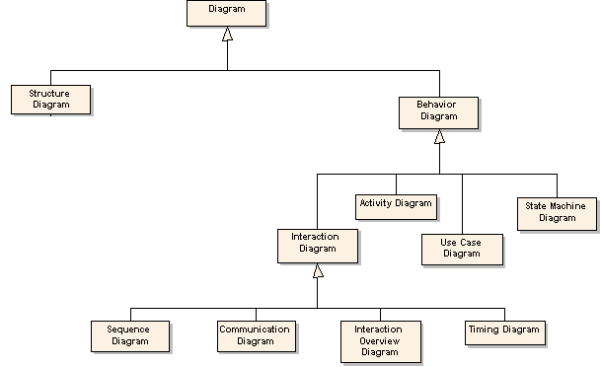
UML Metamodel

Slide 20
Where can UML be used?
Business Model using Activity Diagram
Requirements Capture using Use Case Diagram
Requirements Analysis using Use Case Details and Class Diagram
Initial Design using Sequence Diagrams and second version of Class Diagram
Requirements Analysis using State Diagram
Architecture Design using Packages and Subsystems
Design using next level of details for Class Diagram

Slide 21
Where can UML be used?...
System Architecture using Deployment Diagram
Design using Design Patterns
Detailed design using Collaboration Diagram
Consolidate all information into Class Diagram
Detailed design using Component Diagram
Refine all models through iterations
Implement the models by translating into code
Deploy software within operational environment

Slide 22
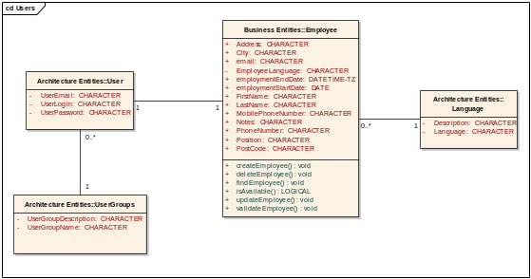
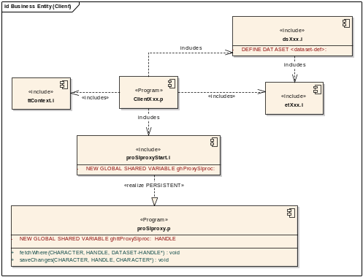
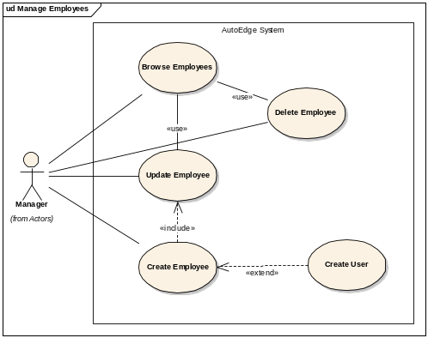
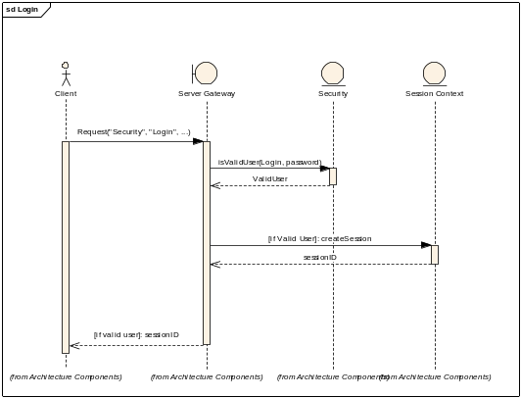
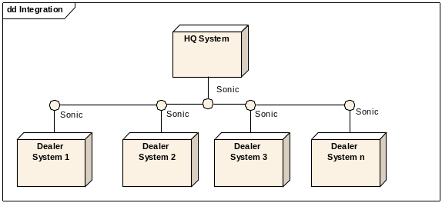
UML Modelling
Logical View
Implementation View
Use Case View
Dynamic View
Deployment View

Slide 23
Use-case View
Gathering requirements
  Functional & non-functional requirements
Document functional requirements
  UML Use Case Diagram
  Use Case Description Documents
Identify actor(s) and association to use case
Create different levels of use cases (re-use!)

Slide 24
Logical View
Identify entities/things used in use case
  Identify attributes
  Identify operations
  Identify entity relations
  Identify multiplicity
Create class diagram

Slide 25
Dynamic View
Identify objects involved
Identify interactions (messages)
  Use public operations
Describe how things work

Slide 26
Implementation View
This view concentrates on taking the Logical view and dividing the logical entities into actual software components.
  Components
  Component Diagrams
  Hierarchy of Classes and Packages

Slide 27
Deployment View
The deployment view shows the hardware topology (e.g. computers and devices) on which the physical system executes.
Hardware elements are called nodes.
  The view is composed of deployment diagrams.

Slide 28
Use-cases
To describe functional System Specifications
To provide starting point for System Design (including GUI)
To provide basis for System Verification tests
To provide a quick checkout for the customer

Slide 29
The Scope of Use Cases
Analysis
Design
and
Implementation
Test
Use cases make up the glue
Capture
use cases
Implement
use cases
Verify that
use cases
are satisfied
User
Understands
Analyst
Expresses
Use Case
Implements
Designs
Verifies
Programmer
Tester
Architect

Slide 30
Use Cases
Use case diagram.
Detailed use case document.

Slide 31
Use Case Diagram
UML artifact to represent the overall system specifications.
A way to conceive and illustrate the use cases.
Shows system boundary, main functionalities, the external entities which can interact with the system.

Slide 32
Notations Used
System boundary
Actors
Use-cases
Flow of information / stimulus

Slide 33
Actors
An actor is an external agent that interacts with the system
An actor stimulates the system with input events, or receives something from it.
<actor’s name>

Slide 34
Use Case
Describes a process from the user’s point of view expressed in the user’s language
A collection of interactions between the system and actors
A Use Case is an end-to-end process description that includes many steps or transactions.
Maintain Orders

Slide 35
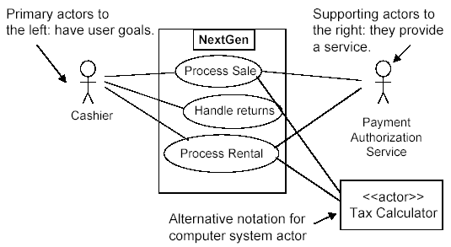
Example: POS

Slide 36
Use-cases
To describe functional System Specifications
To provide starting point for System Design (including GUI)
To provide basis for System Verification tests
To provide a quick checkout for the customer

Slide 37
The Scope of Use Cases
Analysis
Design
and
Implementation
Test
Use cases make up the glue
Capture
use cases
Implement
use cases
Verify that
use cases
are satisfied
User
Understands
Analyst
Expresses
Use Case
Implements
Designs
Verifies
Programmer
Tester
Architect

Slide 38
Use Cases
Use case diagram.
Detailed use case document.

Slide 39
Use Case Diagram
UML artifact to represent the overall system specifications.
A way to conceive and illustrate the use cases.
Shows system boundary, main functionalities, the external entities which can interact with the system.

Slide 40
Notations Used
System boundary
Actors
Use-cases
Flow of information / stimulus

Slide 41
Actors
An actor is an external agent that interacts with the system
An actor stimulates the system with input events, or receives something from it.
<actor’s name>

Slide 42
Use Case
Describes a process from the user’s point of view expressed in the user’s language
A collection of interactions between the system and actors
A Use Case is an end-to-end process description that includes many steps or transactions.
Maintain Orders

Slide 43
Example: POS

Slide 44
Use Case Document
A narrative document that describes the sequence of system events and the system responses originating from the initiating actors of the system.
A use case tells a story of actors using a system
A use-case is a sequence of actions a system performs that yields an observable result of value to a particular actor.

Slide 45
Terms and Concepts
Actor:
  something with behavior, such as a person, computer system, or organization, e.g. a cashier.
Scenario:
  specific sequence of actions and interactions between actors and the system under discussion, e.g. the scenario of successfully purchasing items with cash.
Use case:
  a collection of related success and failure scenarios that describe actors using a system to support a goal.

Slide 46
Scenarios
Main success scenario:
  The normal flow of processing
  e.g., A customer arrives at a checkout with items to return. The cashier uses the POS system to record each returned item…
Alternate scenarios:
  If normal flow deviates, then the alternate course of action
  e.g., If the credit authorization is reject, inform customer and ask for an alternative payment method. If item identifier not found in the system, notify the Cashier and suggest manual entry of the identifier code.

Slide 47
Things to remember!
Choose the system boundary.
Identify primary actors.
  Those that have user goals fulfilled through using services of the system
For each actor, identify their user goals.
Tabulate findings in the Vision artifact.
Define use cases that satisfy user goals; name them according to their goal.

Slide 48
Example: Fully dressed Use Case
Use case UC1: Process Sale
Primary Actor: Cashier
Stakeholders and Interests:
  -Cashier: Wants accurate and fast entry, no payment errors, …
  -Salesperson: Wants sales commissions updated.
Preconditions: Cashier is identified and authenticated.
Success Guarantee (Postconditions):
  -Sale is saved. Tax correctly calculated.
Main success scenario (or basic flow): [on next slide]
Extensions (or alternative flows): [on next slide]
Special requirements: Touch screen UI, …
Technology and Data Variations List:
  -Identifier entered by bar code scanner,…
Open issues: What are the tax law variations? …

Slide 49
UC1: Process Sale
Main success scenario (or basic flow):
  The Customer arrives at a POS checkout with items to purchase.
  The cashier records the identifier for each item. If there is more than one of the same item, the Cashier can enter the quantity as well.
  The system determines the item price and adds the item information to the running sales transaction. The description and the price of the current item are presented.
  On completion of item entry, the Cashier indicates to the POS system that item entry is complete.
  The System calculates and presents the sale total.
  The Cashier tells the customer the total.
  The Customer gives a cash payment (“cash tendered”) possibly greater than the sale total.
Extensions (or alternative flows):
  If invalid identifier entered. Indicate error.
  If customer didn’t have enough cash, cancel sales transaction.

Slide 50
Logical View
Identify entities/things used in use case
  Identify attributes
  Identify operations
  Identify entity relations
  Identify multiplicity
Aim is to create class diagram

Slide 51
Identify Entities
After defining the use cases, the next step is to cross the system boundary.
Open the system “black box”.
Think of the whole system in terms of entities, concepts or objects.

Slide 52
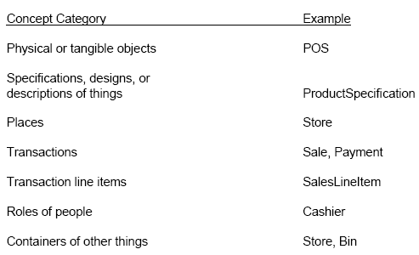
Concept Category List

Slide 53
How to represent entities?
A Domain Model is used to represent entities and it illustrates meaningful concepts in a problem domain.
It is a representation of real-world things, not software components.
It is a set of static structure diagrams; no operations are defined.
It may show:
  concepts
  associations between concepts
  attributes of concepts

Slide 54
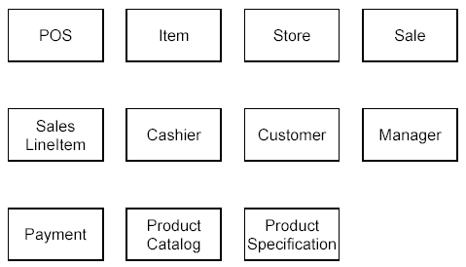
Example: POS

Slide 55
Identify Attributes
An attribute is a logical data value of an object.
For example, a Sales receipt normally includes a date and time.
The Sale concept would need a date and time attribute.

Slide 56
Attributes …
Keep attributes simple.
The type of an attribute should not normally be a complex domain concept, such as Sale or Airport.
Attributes in a Domain Model should preferably be
  Pure data values: Boolean, Date, Number, String, …
  Simple attributes: color, phone number, zip code, universal product code (UPC), ...

Slide 57
Identify Operations
Add operations/method names by analyzing the interaction diagrams.
The methods for each class can be identified by analyzing the interaction diagrams.

Slide 58
Identify Entity Relations
The relationships between the entities identified earlier are known as associations.
An association is a relationship between concepts that indicates some meaningful and interesting connection.
Associations can be named.
Associations can be identified using common association list.

Slide 59
Identify Multiplicities
Multiplicity defines how many instances of a type A can be associated with one instance of a type B, at a particular moment in time.
For example, a single instance of a Store can be associated with “many” (zero or more) Item instances.

Slide 60
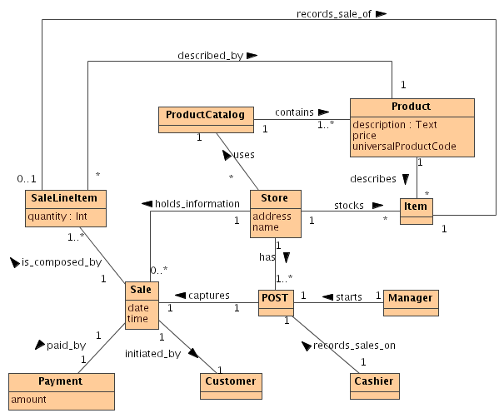
Putting it all together: POS Class Diagram

Slide 61
Dynamic View
Identify objects involved
Identify interactions (messages)
  Use public operations
Describe how things work
UML dynamic views are used to express and model the behavior of a system over time, presented through state machine, interaction, and activity diagrams.

Slide 62
State Machines
State machine diagrams capture the behavior of a software system.
State machines can be used to model the behavior of a class, subsystem, or entire application.
They also provide an excellent way to model communications with external entities via a protocol or event-based system.

Slide 63
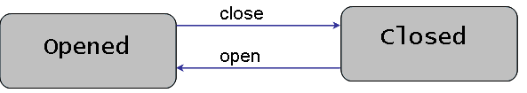
Example-1
The door can have either open state or closed during its life-cycle.
The door changes a state upon triggering of an event.

Slide 64
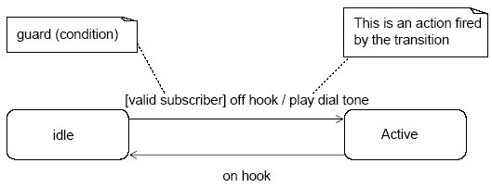
Example-2
The transition can have a guard condition for triggering an event as well as an action fired by the transition.

Slide 65
Sub-states
A state allows nesting to contain Substates.
A substate inherits the transitions of its superstate (the enclosing state).
  Within the Active state, and no matter what substate the object is in, if the on hook event occurs, a transition to the idle state occurs

Slide 66
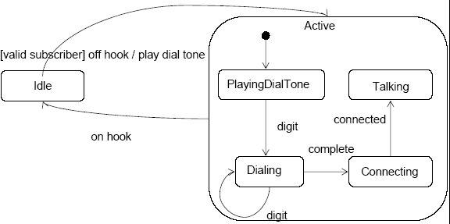
Example

Slide 67
Interaction Diagrams
Interaction diagrams illustrate how objects interact via messages.
They can be:
  Collaboration/Communication Diagram
  Sequence Diagram
Communication diagrams illustrate object interactions in a graph or network format.
Sequence diagrams illustrate interactions in a kind of fence format.

Slide 68
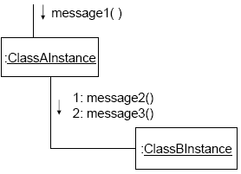
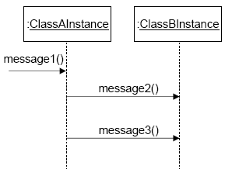

Slide 69
Communication Diagrams
Previously known as Collaboration Diagrams.
They provide a bird’s eye-view of a collection of collaborating objects.
Show the message flow between objects in an OO application and also imply the basic associations (relationships) between classes.

Slide 70
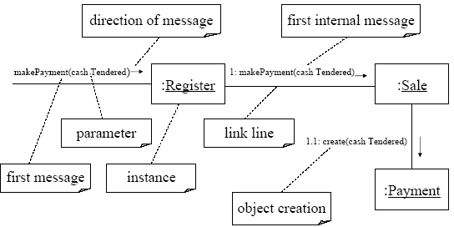
Example - makePayment

Slide 71
Sequence Diagrams
Sequence diagrams are used to display the interaction among users, screens, objects, and entities within the system.
They provide a sequential map of message passing between objects over time.

Slide 72
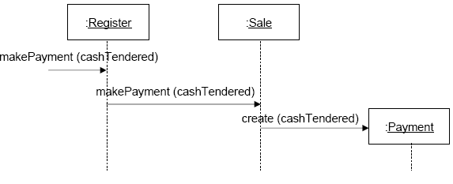
Example - makePayment

Slide 73
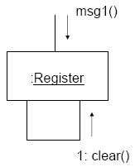

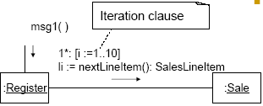
Elements of Interaction Diagrams
A message can be sent from an object to itself.
A message can be conditional and is shown by following a sequence number with a conditional clause in square brackets.
Iteration is indicated by following the sequence number with a star *.

Slide 74
Activity Diagram
Important for modeling system functions.
Emphasizes the flow of objects and synchronization of the flow in support of parallel processing.
An extension of the old "flow chart" diagram combined with Petri nets.

Slide 75
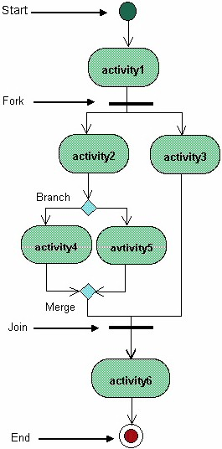
Example-1

Slide 76
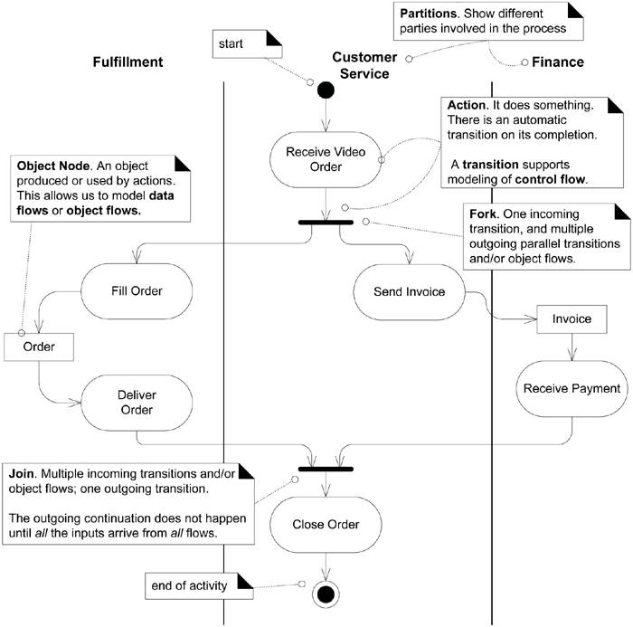

Slide 77
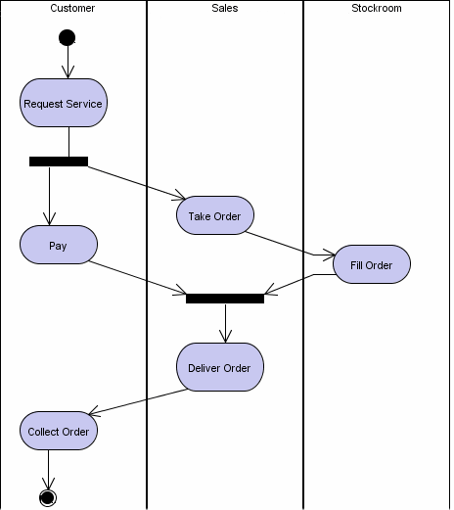
Example-2

Slide 78
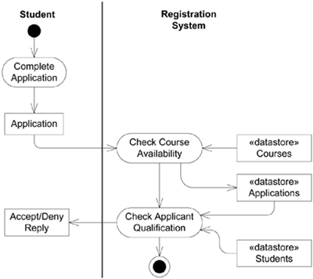

Slide 79
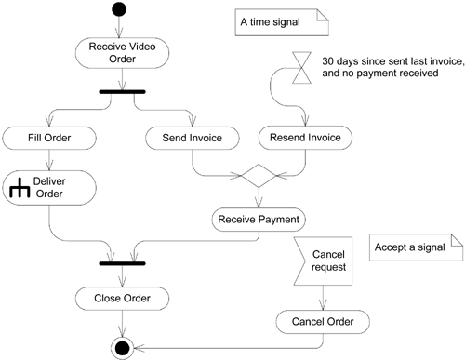
Modelling Signals
Helpful in modeling events
  i.e., time triggering an action, or a cancellation request.

Slide 80
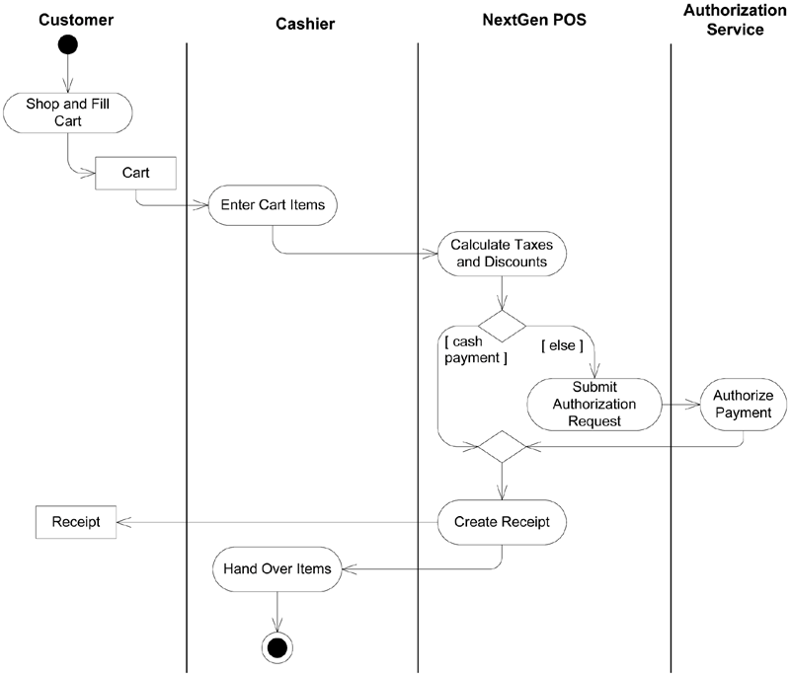

Slide 81
References and further Reading
“Applying UML and Patterns: An Introduction to Object-Oriented analysis and design and iterative development ” 3rd ed. By Craig Larman
  Ch 9: Domain Models
  Ch 10: System Sequence Diagrams
  Ch 15: UML Interaction Diagrams
  Ch 28: UML Activity Diagrams and Modeling

